Slide 1
How to write your first programs
Prepared by
Ravikumar R(Ravikumarr@gmail.com)

Slide 2
How to write your first programs
Basic coding skills
How to work with data types and variables
How to work with numeric data
How to work with string data
How to use five of the Python functions
Two illustrative programs

Slide 3
Basic coding skills
Coding rules
Python relies on proper indentation. Incorrect indentation causes an error.
The standard indentation is four spaces whenever it is required.
With implicit continuation, you can divide statements after parenthesis, brackets, and braces, and before or after operators like plus or minus signs.
With explicit continuation, you can use the ‘\’ character to divide statements anywhere on a line.

Slide 4
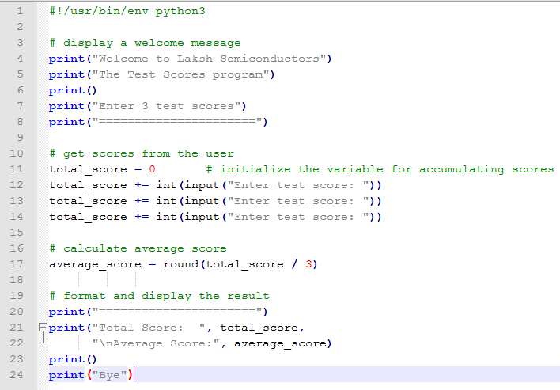
How to code statements

Slide 5
How to code statements(Continued…)
Description
A statement performs a task. Each statement must be indented properly.
A program typically starts with a shebang line that begins with a hash (#) symbol followed by a bang (!) symbol. This line identifies the interpreter to use when running the program.
If you’re using IDLE to run your programs, you don’t need a shebang line. However, it’s generally considered a good practice to include one.

Slide 6
An indentation error
print(“Total Score: “ + str(score_total))
print(“Average Score: “ + str(average_score))
SyntaxError: unexpected indent
Description
The indentation of each line matters in a Python program.
With Python, the indentation is typically four spaces.

Slide 7
Two ways to continue one statement over two or more lines
Implicit Continuation
print(“Total Score: “ + str(score_total)
+ “\nAverage Score: “ + str(average_score))
Explicit Continuation
print(“Total Score: “ + str(score_total) \
+ “\nAverage Score: “ + str(average_score))

Slide 8
Implicit Continuation
Implicit Continuation
print(“Total Score: “ + str(score_total)
+ “\nAverage Score: “ + str(average_score))
Description
In some case, you’ll want to divide a long statement over two or more lines. To do that, you divide a statement before or after an operator like a plus or minus sign.
You can also divide a statement after an opening parentheses.
When you divide the statement, it’s a good practice to indent its continuation lines. This is illustrated in the above example.

Slide 9
Explicit Continuation
Explicit Continuation
print(“Total Score: “ + str(score_total) \
+ “\nAverage Score: “ + str(average_score))
Description
The other way to continue a statement is to use explicit continuation.
Then, you code a backslash to show that a line is continued.
In general, this is discouraged and isn’t usually required, so you shouldn’t need to use it often.

Slide 10
How to code comments
Guidelines for using comments
Use comments to describe portions of code that are hard to understand, but don’t overdo them.
Use comments to comment out (or disable) statements that you don’t want to test.
If you change the code that’s described by comments, change the comments too.

Slide 11
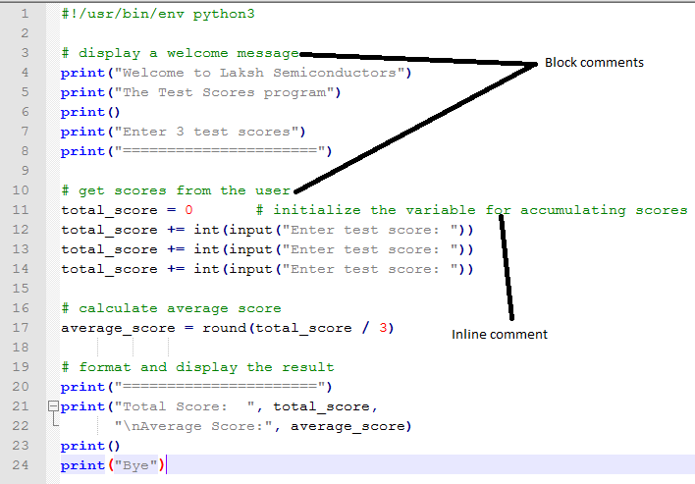
How to code comments (Continued…)

Slide 12
How to code comments (Continued…)
Description
Comments start with the #sign, and they are ignored by the compiler. Block comments are coded on their own lines. Inline comments are coded after statements to describe what they do.
Comments are used to document what a program or portion of code does. This can be helpful not only to the programmer who creates the program, but also to those who maintain the program later.
Comments can also be used to comment out statements so they aren’t executed when the program is tested. Later, the statements can be uncommented so the statements will be executed when the program is tested. This can be helpful when debugging.

Slide 13
How to use functions
A function is a reusable unit of code that performs a specific task.
Python provides many built-in functions that do common tasks like getting input data from the user and printing output data to the console.
When you call a function, you code the name of the function followed by a pair of parentheses. Within the parentheses, you code any arguments that the function requires, and you separate multiple arguments with comma.
The syntax for calling any function
function_name([arguments])
Note : The brackets [] mark the portions of code that are optional

Slide 14
The print() function
Function | Description
print([data)] | Prints the data argument to the console followed by a new line character. If the call doesn’t include a data argument, this functions prints a blank line to the console.
A script with three statements
print(“Hello, World!”)
print()
print(“Good morning!”)
The console after the program runs
Hello, World!
Good morning!

Slide 15
How to work with data types and variables
When you develop a Python program, you work with variables that store data.
Three Python data types
The str (or string) data type holds any characters like “Laksh” or “108”
The int (or integer) data type holds whole numbers like 22 or -18
The float (or floating-point) data type holds numbers with decimal places like 22.34 or -75.42
Data type | Name | Examples
str | String | “Laksh” “108” ‘Please enter your name'
int | Integer | 22 0 -18
float | Floating-point | 22.34 345.78 0.05 -75.42

Slide 16
How to assign values to variables
When you work with these data types in a program, you normally assign them to variables. To do that, you code assignment statements like these
Code that initializes variables and assigns data to them
first_name = “Laksh” # sets first_name to a str of “Laksh”
quantity1 = 5 # sets quantity1 to an int value of 5
quantity2 = 12 # sets quantity2 to an int value of 12
list_price = 19.99 # sets list_price to a float value of 19.99

Slide 17
How to assign values to variables
Code that assigns new data to the variable from previous slide
Code that causes an error because of incorrect case
first_name = “Ram” # sets first_name to a str of “Ram”
quantity1 = 25 # sets quantity1 to an int value of 25
quantity1 = quantity2 # sets quantity1 to an int value of 12
quantity1 = “15” # sets quantity1 to a str of “15”, not an int of 12
quantity1 = Quantity2 # NameError: ‘Quantity2’ is not defined

Slide 18
How to code literal values
To code a literal value for a string, enclose the characters of the string in single or double quotation marks. This is called string literal.
To code a literal value for a number, code the number without quotation marks. This is called numeric literal.
Examples of string literal
name = “Laksh”
Examples of integer literal
num = 108
Examples of floating-point literal
total = 87.95

Slide 19
Key points (data types and variables)
A variable can change, or vary, as code executes.
A data type defines the type of data for the value.
An assignment statement uses the equal sign (=) to assign a value to a variable. The value can be a literal value, another variable, or an expression like arithmetic expression (we will see in the forthcoming slides).
You can assign a value of any data type to a variable, even if that variable has previously been assigned to a value of a different data type.
Because variable names are case-sensitive, you must be sure to use the correct case when coding the names of variables

Slide 20
How to name variables
Rules for naming variables
A variable name must begin with a letter or underscore.
A variable name can’t contain spaces, punctuation, or special characters other than the underscore.
A variable name can’t begin with a number, but can use numbers later in the name
A variable name can’t be the same as a keyword that’s reserved by Python

Slide 21
Python keywords
and | as | assert | break
class | continue | def | del
elif | else | except | False
finally | for | from | global
if | import | in | is
lambda | None | nonlocal | not
or | pass | raise | return
True | try | while | with
yield

Slide 22
Two naming styles for variables
variable_name # underscore notation
variableName # camel case
Description
With underscore notation, all letters are lowercase with words separated by underscores.
With came case notation, the first word is lowercase and subsequent words start with a capital letter.
Examples
tax_rate, monthly_investment # underscore notation
taxRate, monthlyInvestment # camel casing

Slide 23
Recommendations for naming variables
Start all variable names with a lowercase letter.
Use underscore notation or camel case.
Use meaningful names that are easy to remember.
Don’t use the name of built-in functions, such as print()

Slide 24
How to work with numeric data
That’s something you will do in just about every program that you write.
Python’s arithmetic operators
Operator | Name | Description
+ | Addition | Adds two operands
- | Subtraction | Subtracts the right operand from the left operand.
* | Multiplication | Multiplies two operands.
/ | Division | The result is always a floating-point number.
// | Integer division | Drops the decimal portion of the result
% | Modulo | Returns the remainder (always an integer)
** | Exponentiation | Raises to the power of the right operand

Slide 25
Examples with two operands
Example | Result
5 + 4 | 9
25 / 4 | 6.25
25 // 4 | 6
25 % 4 | 1
3 ** 2 | 9

Slide 26
The order of precedence for arithmetic operators
Order | Operators | Direction
1 | ** | Left to right
2 | * / // % | Left to right
3 | + - | Left to right

Slide 27
Examples that show the order of precedence and use of parentheses
Example | Result
3 + 4 * 5 | 23 (multiplication is done first)
(3 + 4) * 5 | 35 (the addition is done first)

Slide 28
Key points (how to work with numeric data)
An arithmetic expression consists of one or more operands that are operated upon by arithmetic operators.
You don’t have to code spaces before and after the arithmetic operators.
When an expression mixes integers and floating-point numbers, Python converts the integers to floating-point numbers.
If you use multiple operators in one expression, you can use parentheses to clarify the sequence of operations. Otherwise, Python applies its order of precedence.

Slide 29
How to use arithmetic expressions in assignment statements
Code that calculates sales tax
Code that calculates the perimeter of a rectangle
subtotal = 200.0
tax_percent = .05
tax_amount = subtotal * tax_percent # 10.0
grand_total = subtotal + tax_amount # 210.0
width = 4.25
length = 8.5
perimeter = (2 * width) + (2 * length) # (8.5 + 17) = 25.5

Slide 30
The most useful compound assignment operators
Two ways to increment the number in a variable
Besides the compound assignment operators in the table, Python offers /= //= %= **=
Operator | Description
+= | Adds the result of the expression to the variable
-= | Subtracts the result of the expression from the variable
*= | Multiplies the variable value by the result of the expression
counter = 0
counter = counter + 1 # counter = 1
counter += 1 # counter = 2

Slide 31
Code that adds two numbers to a variable
More statements that use the compound assignment operators
score_total = 0 # score_total = 0
score_total += 70 # score_total = 70
score_total += 80 # score_total = 150
total = 1000.0
total += 100.0 # total = 1100.0
counter = 10
counter -= 1 # counter = 9
price = 100
price *= .8 # price = 80.0

Slide 32
A floating-point result that isn’t precise
subtotal = 74.95 # subtotal = 74.95
tax = subtotal * .1 # tax = 7.495000000000001
Description
Besides the assignment operator (=), Python provides compound assignment operators. These operators are a shorthand way to code common assignment operations.
When working with floating-point numbers, be aware that they are approximations, not exact values. This can cause inaccurate results.

Slide 33
How to work with string data
That’s another thing you will do in just about every program you write
How to assign strings to variables
How to concatenate or join three strings with the + operator
name = last_name + “, “ + first_name # name is “Doe, John”
first_name = “John” # first_name = John
last_name = “Doe” # last_name = Doe
name = “” # name = empty string
name = “John Doe” # name = John Doe

Slide 34
The str() function for converting numbers to strings
How to join a string and a number with the str() function
What happens if you don’t use the str() function
Function | Description
str(data) | Converts a numeric argument to a string and returns the string
name = “John Doe”
age = 25
message = name + “ is “ + str(age) + “ years old.”
message = name + “ is “ + age + “ years old.”
TypeError: must be str, not int
Note : Python can’t implicitly convert an int object to a string

Slide 35
Implicit continuation of a string over several coding lines
If you use joins to create long strings, you will sometimes want to code the statement over two or more lines. To do that, you can use implicit continuation.
In this case, the statement can be divided before or after the plus sign.
print(“Total Score: “
+ str(score_total)
+ “\nAverage Score : “
+ str(average_score))

Slide 36
Key points (how to work with string data)
A string can consist of one or more characters including letters, numbers and special characters like *, &, and #
To specify the value of a string, you can enclose the text in either double or single quotation marks. This is known as a string literal.
To assign an empty string to a variable, you code a set of quotation marks with nothing between them. This means that the string doesn’t contain any characters.
To convert a numeric variable to a string, you can call the str() function with the numeric variable as the argument.

Slide 37
How to include special characters in strings
The table below shows six of many escape sequences
These sequences let you put characters in a string that you can’t put in just by pressing the appropriate key on the keyboard.
Sequence | Character
\n | New line
\t | Tab
\r | Return
\” | Quotation mark in a double quoted string
\’ | Quotation mark in a single quoted string
\\ | Backslash

Slide 38
The new line character
print(“Title : Python Programming\nQuantity: 20”)
Displayed on the console
Title : Python Programming
Quantity: 20

Slide 39
The tab and new line characters
print(“Title:\t\tPython Programming\nQuantity:\t20”)
Displayed on the console
Title : Python Programming
Quantity: 20

Slide 40
The backslash in a Windows path
print(“C:\\books\\python”)
Displayed on the console
C:\books\python

Slide 41
Four way to include quotation marks in a string
“Type \”x\” to exit” # String is: Type “x” to exit.
‘Type \’x\’ to exit’ # String is: Type ‘x’ to exit.
“Type ‘x’ to exit” # String is: Type ‘x’ to exit.
‘Type “x” to exit’ # String is: Type “x” to exit.

Slide 42
Key points (how to include special characters in a string)
Within a string, you can use escape sequences to include certain types of special characters such as new lines and tabs.
You can also use escape characters to include special characters such as quotation marks and backslashes.
Another way to include quotation marks in a string is to code single quotes within a string that’s in double quotes, or vice versa.

Slide 43
How to use five of the Python functions
How to use the print() function
The syntax of the print() function
Three print() functions that receive one or more arguments
print(data[, sep=‘ ‘][, end=‘\n’])
print(28.99) # 28.99
print(“Price:”, 28.99) # Price: 28.99
print(1, 2, 3, 4) # 1 2 3 4

Slide 44
How to use the print function (Continued…)
Two ways to get the same result
A print() function that receives four arguments
A print() function that receives one string as the argument
print(“Total Score:”, score_total,
“\nAverage Score:”, average_score)
Print(“Total Score: “ + str(score_total) +
“\nAverage Score: “ + str(average_score))

Slide 45
How to use the print function (Continued…)
Examples that use the sep and end arguments
print(1, 2, 3, 4, sep=‘ | ’) # 1 | 2 | 3 | 4
print(1, 2, 3, 4, end=‘***’) # 1 2 3 4***

Slide 46
Key points (how to use the print function)
The print() function can accept one or more data arguments.
If you pass a series of arguments to the print() function, numbers don’t have to be converted to strings.
If you pass just one string as the argument for a print() function, numbers have to be converted to strings within the string argument.
The print() function provides a sep argument that can change the character that’s used for separating the strings from one space to something else.
The print() function also provides an end argument that can change the ending character for a print() function from a new line character(\n) to something else.

Slide 47
How to use the input() function
The input function for getting data from the console
The syntax of the input() function
Hello
Function | Description
input([prompt]) | Pauses the program and waits for the user to enter data at the console. When the user presses Enter, this function returns the data entered by the user as a str value. If the call includes a prompt argument, this function prints the prompt to the console before passing to wait for the user to enter data.

Slide 48
How to use the input() function (Continued…)
Code that gets string input from the user
The console
first_name = input(“Enter your first name: “)
print(“Hello, “ + first_name + “!”)
Enter your first name: Laksh
Hello, Laksh!

Slide 49
How to use the input() function (Continued…)
Another way to get input from the user
The console
print(“What is your first name?”)
first_name = input()
print(“Hello, “ + first_name + “!”)
What is your first name?
Laksh
Hello, Laksh!

Slide 50
How to use the input() function (Continued…)
Code that attempts to get numeric input from the user
The console
score_ total = 0
score = input(“Enter your score: “)
score_total += score # causes an error because score is a string
TypeError: unsupported operand type(s) for +=: 'int' and 'str'

Slide 51
Key points (how to use the input function)
You can use the input() function to get user input from the console. Typically, you assign the string that’s returned by this function to a variable.
The input() function always returns string data, even if the user enters a number.

Slide 52
How to use the int(), float() and round() functions
The int() and float() functions convert the data argument, which is typically a str value, to int or float values.
In contrast, the round() function rounds a numeric value to the specified number of digits.
Three functions for working with numbers
Function | Description
int(data) | Converts the argument to int type and returns it
float(data) | Converts the argument to float type and returns it
round(number, [,digits]) | Rounds the number of argument to the number of decimal digits. If no digits are specified, it rounds the number to the nearest integer.

Slide 53
How to use the int() function
Code that causes an exception
The console
How using the int() function fixes the exception
x = 15
y = “5”
z = x + y # TypeError : can’t add an int to a str
TypeError: unsupported operand type(s) for +: 'int' and 'str'
x = 15
y = “5”
z = x + int(y) # z is 20

Slide 54
How to chain functions
Code that gets an int value from the user
How to use chaining to get the int value in one statement
quantity = input(“Enter the quantity: “) # quantity is str type
quantity = int(quantity) # quantity is int type
quantity = int(input(“Enter the quantity: “)) #quantity is int type

Slide 55
How to use the float() function
Code that gets an float value from the user
How to use chaining to get the float value in one statement
price = input(“Enter the price: “) # price is str type
price = float(price) # price is float type
quantity = float(input(“Enter the quantity: “)) #quantity is float type

Slide 56
How to use the round() function
Code that uses the round() function
How to combine the last two statements
miles_driven = 150
gallons_used = 5.875
mpg = miles_driven / gallons_used # mpg = 25.53191489361702
mpg = round(mpg, 2) # mpg = 25.53
mpg = round(miles_driven / gallons_used, 2) # mpg = 25.53

Slide 57
Key points (how to use the int, float and round functions)
If you try to perform an arithmetic operation on a string, an exception occurs. To fix that, you can use the int() and float() functions.
When you chain functions, you code one function as the argument of another function. This is a common coding practice

Slide 58


Slide 59


